Slide 1

Music Emotion
Bin Wu
http://www.cse.ust.hk/~bwuaa/
Hong Kong University of Science and Technology

Slide 2
What can music emotion be used for?
How?

Slide 3
Outline
Introduction
Music emotion perception
Music emotion recognition

Slide 4
What may be included in mid-term?
6 pts. Basic concepts (no calculation)
p13-p17
p24-p28
p37-p42

Slide 5
What is MUSIC EMOTION?
Introduction

Slide 6

Music & Emotion
Music is the shorthand of emotion. ~Leo Tolstoy
Music is the only means whereby we feel emotions in their universality. ~H.A. Overstreet

Slide 7
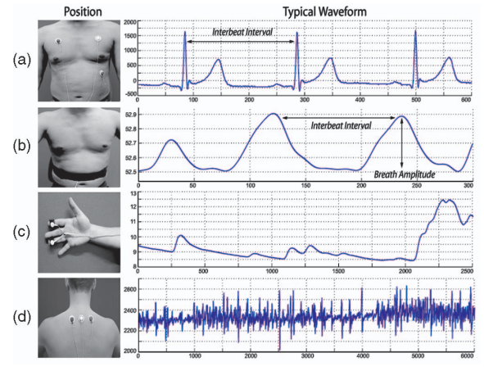
Does music affects emotion?
Music affects physical conditions such as respiration, heart beat rate, skin conductivity, etc.
Music affects purchase intention, choice, brand attitude, etc.

Slide 8

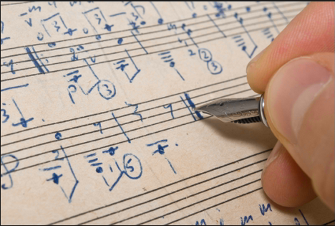
Applications – emotion triggering

Slide 9
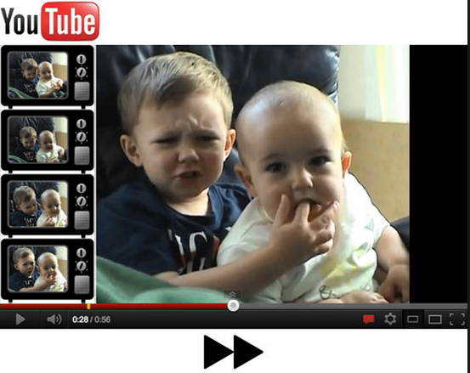
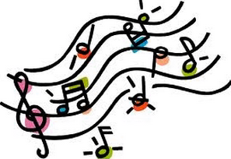

Applications – information retrieval

Slide 10
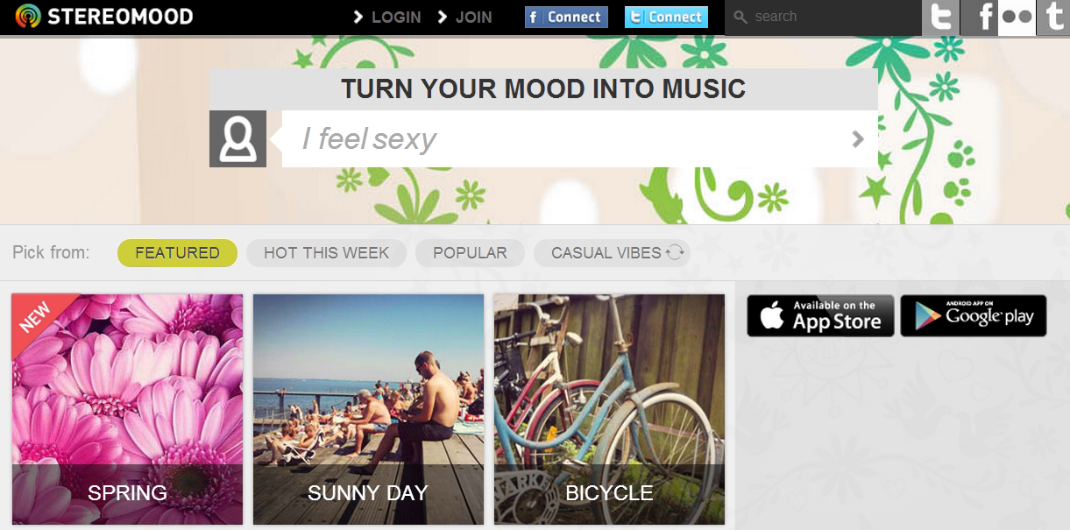
Applications - Stereomood
https://www.stereomood.com/

Slide 11

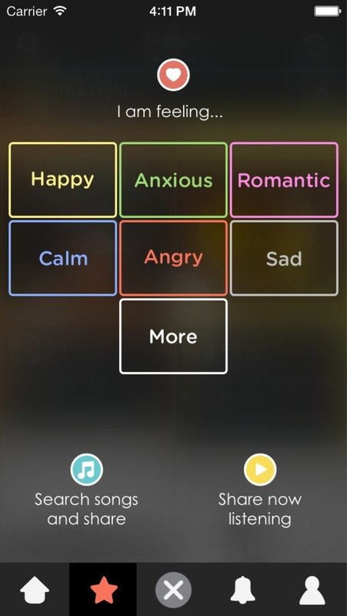
Applications - Sensbeat

Slide 12
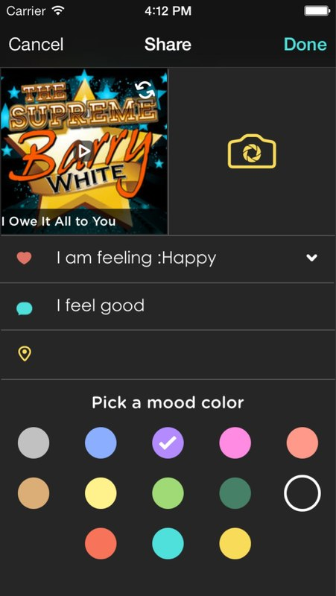
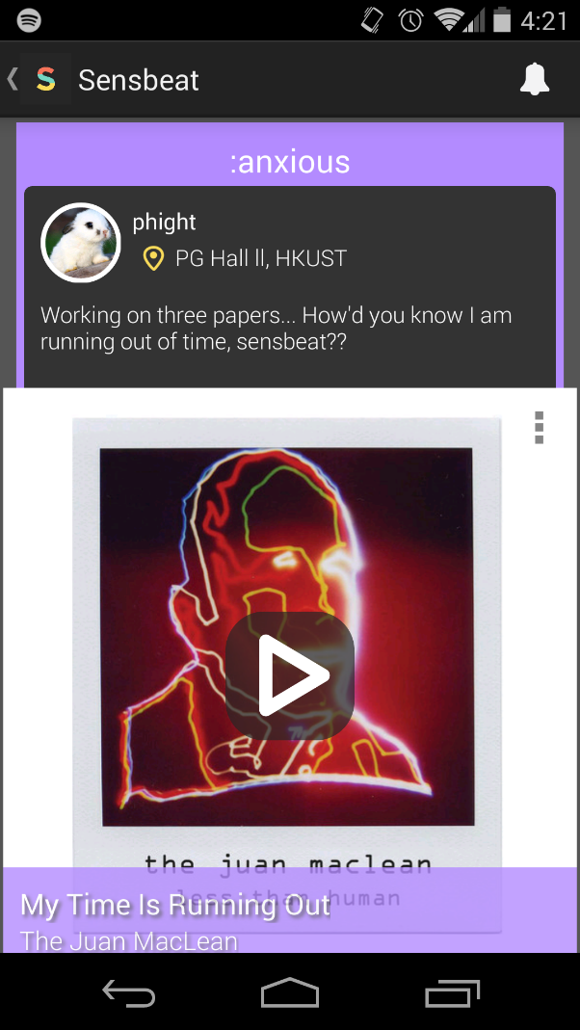
Applications – Sensbeat (cont’d)

Slide 13
Music emotion - definition
In computer music, music emotion is defined as: what emotions are expressed by music.
Not to be confused: what emotions human feel after listening to music.

Slide 14
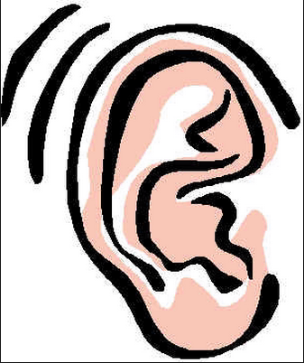


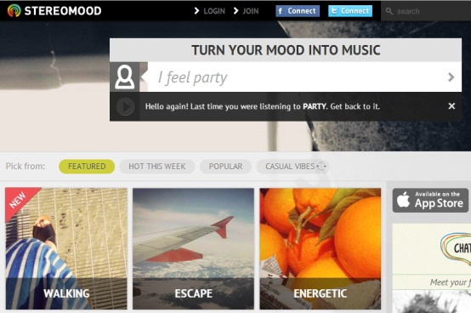

Music emotion perception and recognition
Music emotion perception
Why Happy??
Why Sad??
Happy
Sad
Hey Jude
Machine
Learning
Yesterday once more
Happy??
Sad??
Music emotion recognition

Slide 15
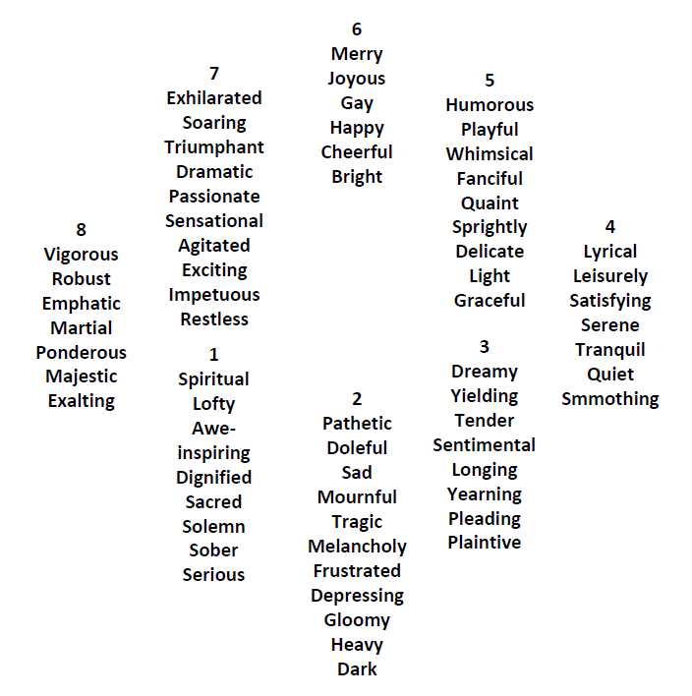
How to represent emotion?
Categorical model
Hevner’s eight-emotion adjective groups

Slide 16
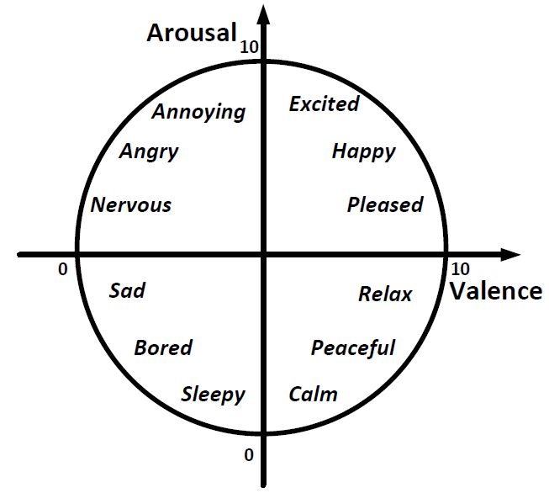
How to represent emotion: Dimensional model
(how strong or weak)
[6.5,7.8]
(how positive or negative)
Russel’s valence-arousal model

Slide 17

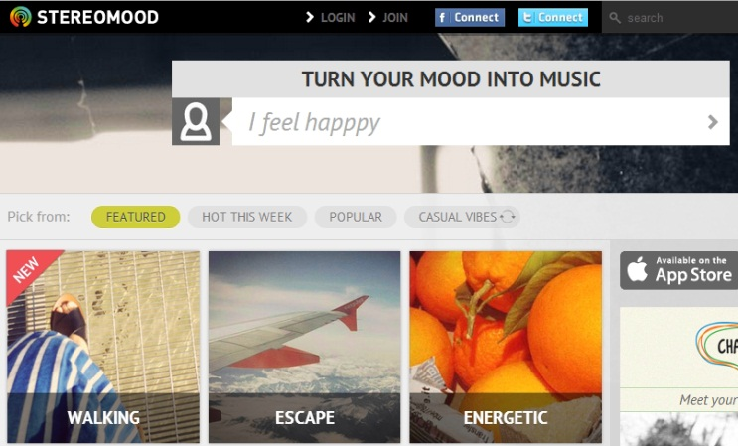
Categorical vs. Dimensional
Listening test:
e.g., Happy (6.5,7.8)
[6.5,7.8]
Clustering
Easy to interpret:
Which instrument sounds happier?
Finer granularity:
Which is the best party music?

Slide 18
What makes us fell?
Music emotion perception

Slide 19
Music emotion perception
Location?
Mood?
Taste?
Experience
Context
Personality
Weather?
Activity?
Age?
Noise?
Gender?
Temperature?
Previous music?
Cultural background?
Why Happy??
Why Sad??
Hey Jude
Yesterday once more
Tempo?
Features of music
Lyrics?
Instruments?
Strength?
Brightness?
Chords?
Melody?

Slide 20


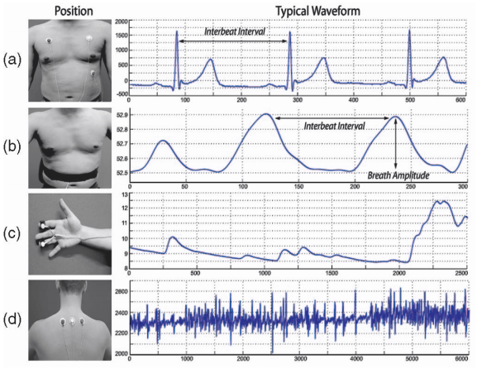
Methodology
Tempo?
Lyrics?
Instruments?
Melody?
Strength?
Brightness?
Chords?

Slide 21
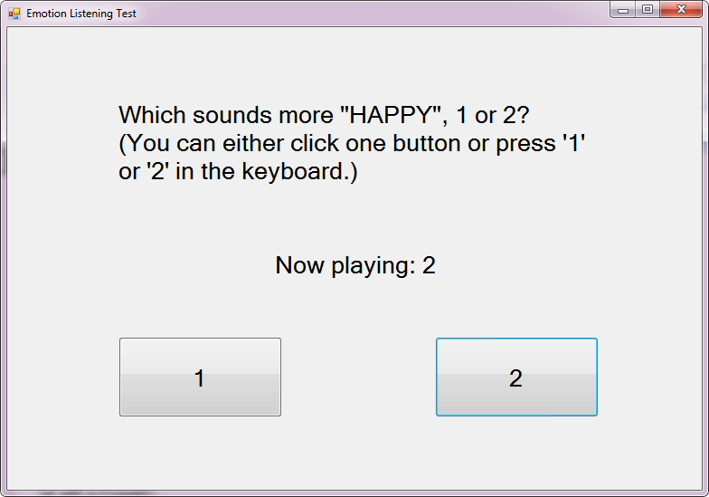
Example
Trumpet, violin, horn, oboe, saxophone, clarinet, flute, bassoon.

Slide 22
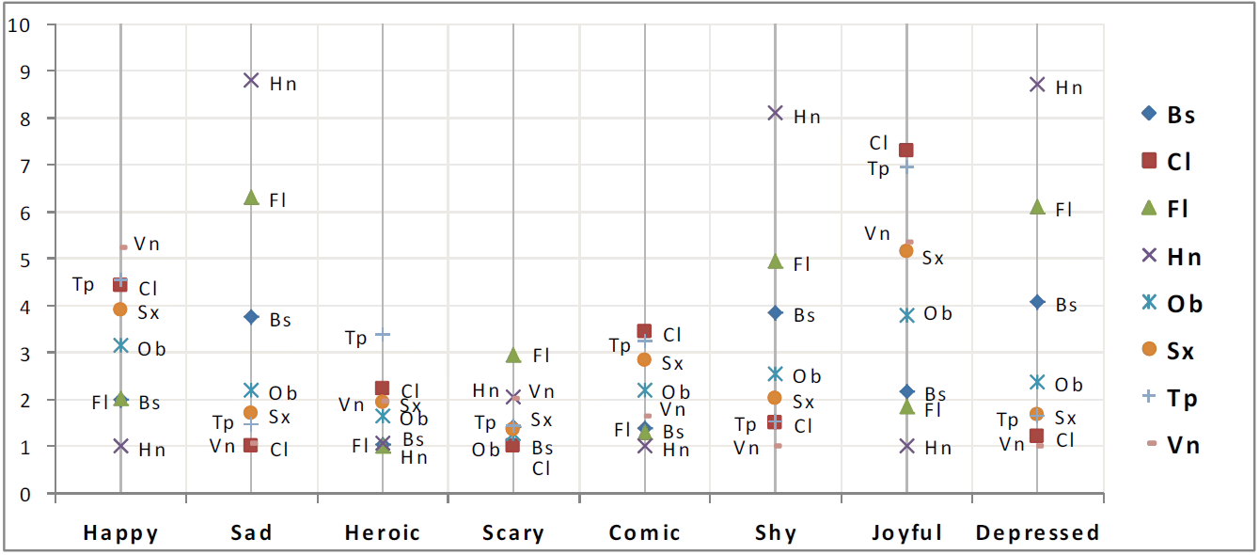
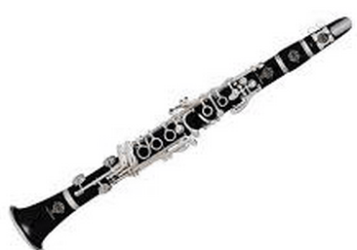
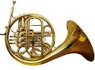
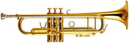

Emotion ratings of instruments

Slide 23
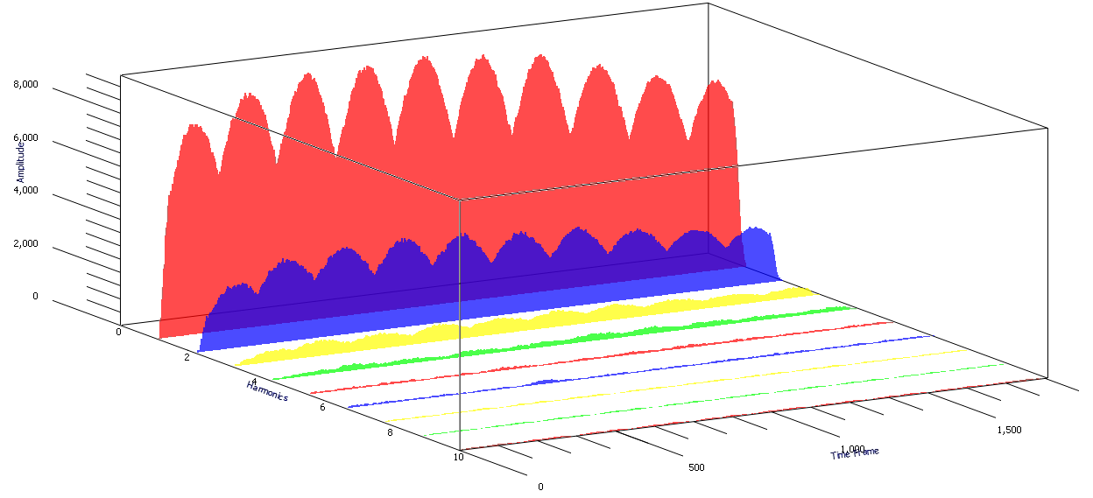
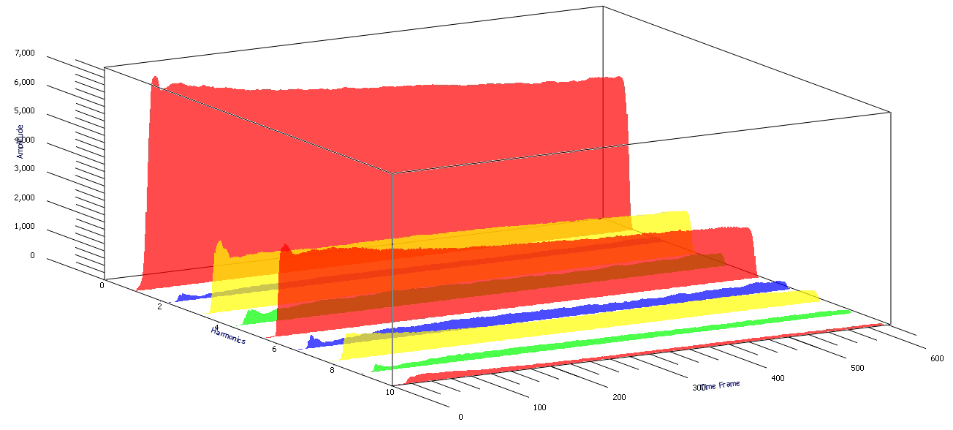
Why they sound different in emotion?
Horn
Clarinet

Slide 24

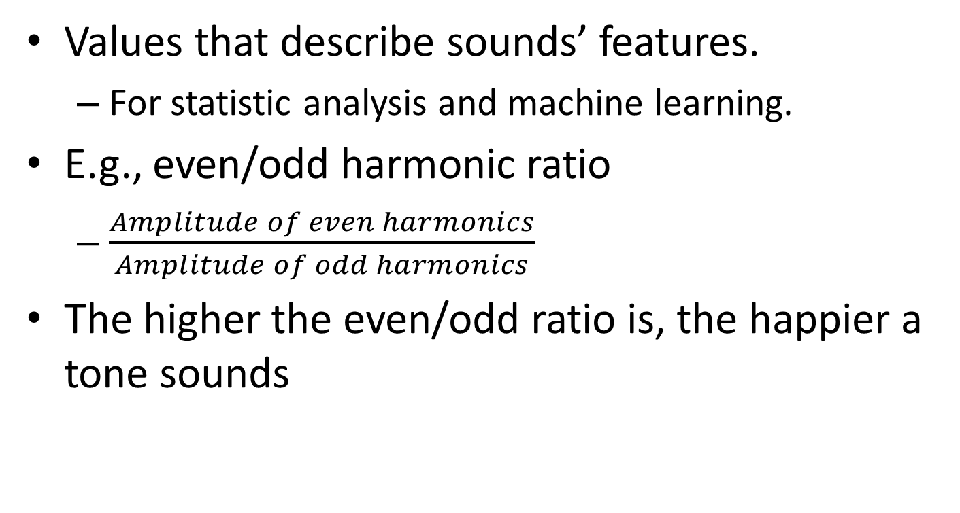
Feature Extraction
Values that describe sounds’ features.
For statistic analysis and machine learning.
E.g., even/odd harmonic ratio
$\frac{Amplitude of even harmonics}{Amplitude of odd harmonics}$
The higher the even/odd ratio is, the happier a tone sounds

Slide 25
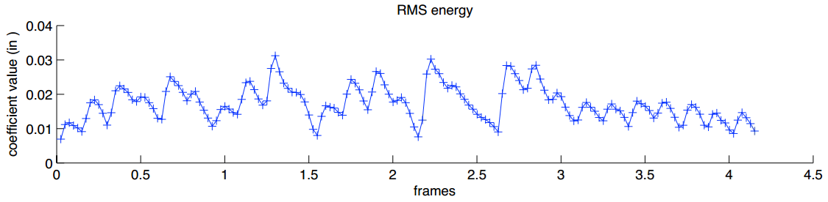
Musical features and emotion
Energy
Dramaticness of a music clip.
E.g., root mean square energy, low energy, and loudness
Energy ↑, arousal ↑.
Strong or weak

Slide 26
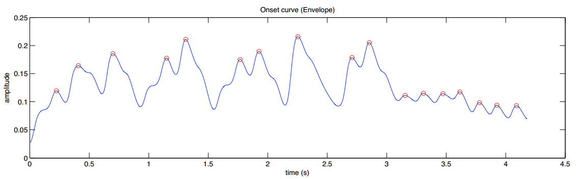
Musical features and emotion (cont’d)
Rhythm
Periodicity and strength of the pulse pattern.
E.g., onset curve.
The faster and stronger the rhythm, the higher the arousal.

Slide 27
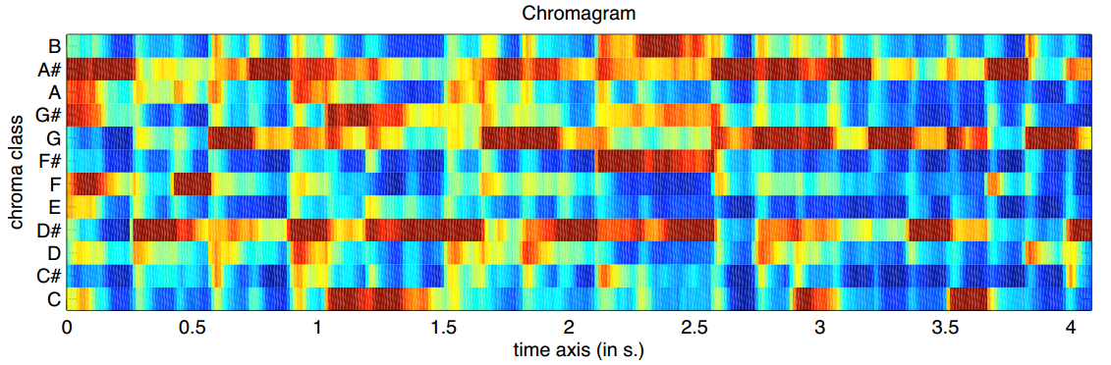
Musical features and emotion (cont’d)
Melody
Pitch, harmony.
E.g., chromagram.
No clear correlation with emotion known.

Slide 28
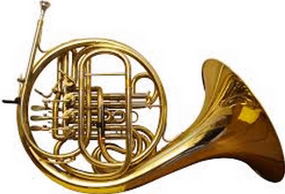
Musical features and emotion (cont’d)
Timbre
Color of sounds.
E.g., brightness.
Brightness ↑, valence ↑, arousal ↑
Most salient in music emotion recognition.
Original:
Brighter:
Positive or negative

Slide 29
How computers know how we feel?
Music emotion recognition

Slide 30
Music emotion perception
Music emotion perception
Why Happy??
Why Sad??
Happy
Sad
Hey Jude
Tempo
Yesterday once more
Melody
Strength
Brightness
Chords

Slide 31
Music emotion recognition
Tempo
Melody
Strength
Brightness
Chords
Happy
Sad
Hey Jude
Yesterday once more
Happy??
Sad??

Slide 32
Example – Sensbeat music emotion recognition
There are 37m songs in itunes.
How do we know the emotions of all the songs?
How about new songs in the future?

Slide 33

Machine learning
Labeled Music
Unlabeled Music
Train
Tempo
Lyrics
Melody
Strength
Brightness
Chords
Predict

Slide 34
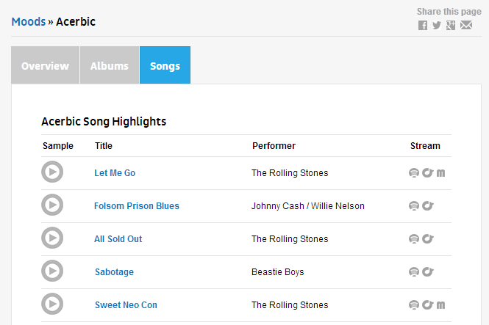
Machine learning – labels
AllMusic – 300 emotions labeled on 10000 songs.

Slide 35
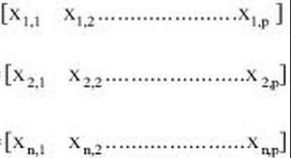
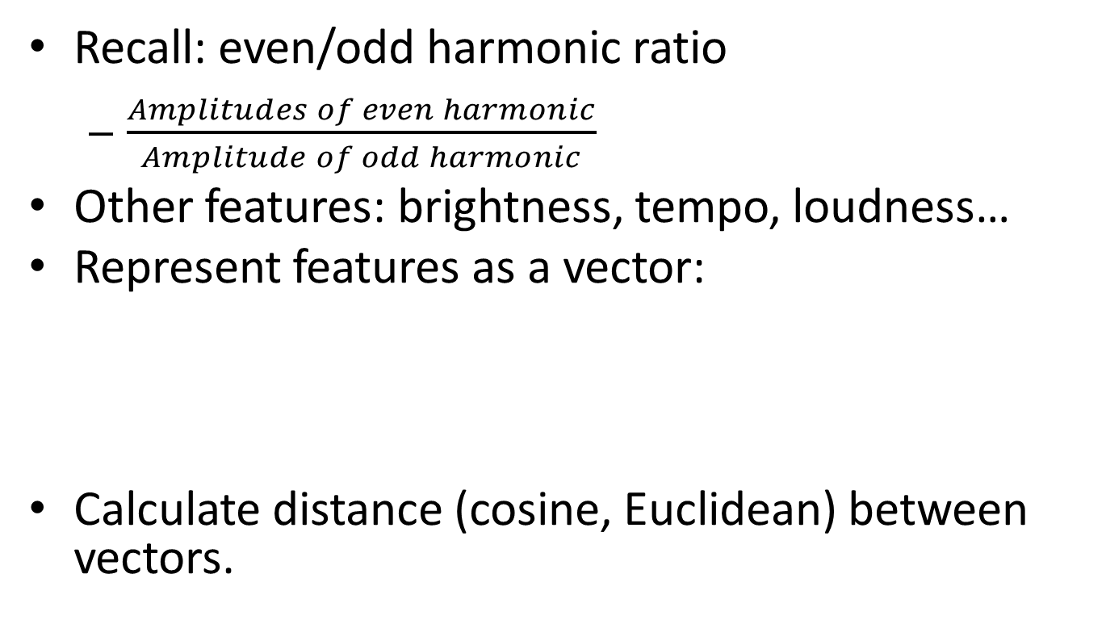
Machine learning – features extraction
Recall: even/odd harmonic ratio
$\frac{Amplitudes of even harmonic}{Amplitude of odd harmonic}$
Other features: brightness, tempo, loudness…
Represent features as a vector:
Calculate distance (cosine, Euclidean) between vectors.

Slide 36


In Sensbeat…
Calculate distance and label.
37m songs in Itunes.
10k emotion-song pairs from AllMusic.

Slide 37
Music emotion properties – for music emotion recognition
Genre-specific
Personal/context dependent
Time-varying

Slide 38
Genre-specific
Imagine if you are a classical music listener, what emotion you perceive from heavy metal?
Classical
Heavy metal
Important for music emotion recognition!

Slide 39
Personal/context dependent
Music emotion is affected by:
Taste, age; activity, physical condition, previous music, background environment, weather…
Important for recommendation: based on the personality and context, what music shall we recommend?

Slide 40
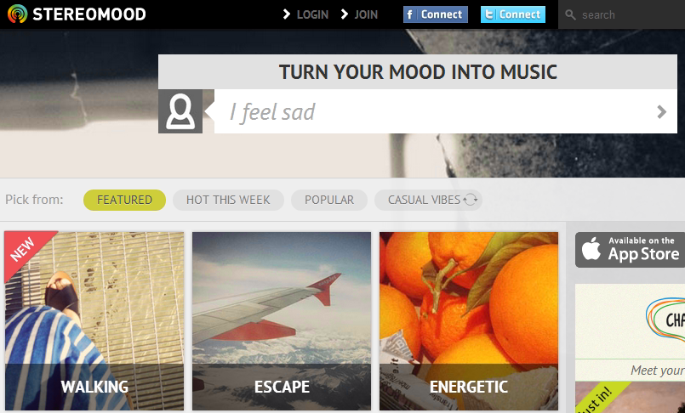
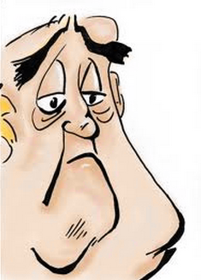
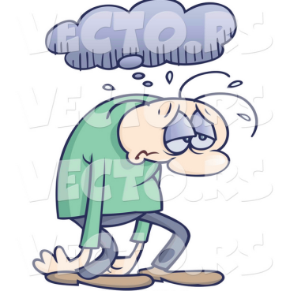

Personal/context dependent (cont’d)
“Tears in
Heaven”
Songs to recommend when you feel:
Sad: sad or calm songs.
Bored: angry or fun songs…

Slide 41
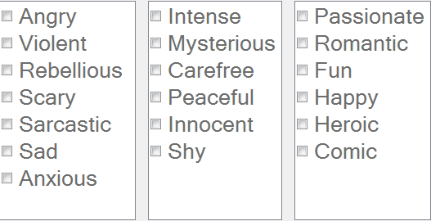
Time-varying
We are the champion: theme A? theme B?
Music usually have multiple emotions.
Emotion changes along time. How?
romantic -> sad -> sarcastic -> angry -> CRAZY?

Slide 42
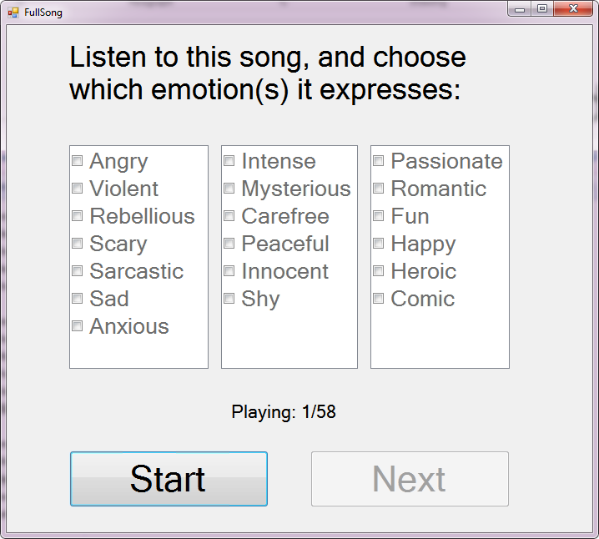
Time-varying (cont’d)
An advertisement: You will be paid 200+ HKD for listening great music for 1.5 hours!

Slide 43
Q & A

Slide 44
Thank you!
Hope you enjoy!

